Slide 1
PIZZA SALES ANALYSIS

Slide 2
TABLE OF CONTENTS
INTRODUCTION
01
02
GOALS & KPIs
03
04
CONCLUSION
RECOMMENDED ANALYSIS
Problem Statement & Background

Slide 3
INTRODUCTION
PROBLEM STATEMENT & BACKGROUND
Investigate the pizza sales data to identify trends, patterns, and insights pivotal for strategic decision-making. This comprehensive analysis will encompass key performance indicators such as total revenue, average order value, total pizzas sold, total orders, and average pizzas per order. By dissecting sales patterns by category and size, identifying peak sales times, and determining top and bottom-selling items, our aim is to optimize operational efficiency and enhance customer satisfaction. The goal is to leverage these insights to refine marketing strategies, menu offerings, and overall business approach, ultimately driving increased profitability and sustained growth.

Slide 4
SOLUTION
Our solution involves conducting a thorough analysis of our pizza sales data using advanced analytical techniques. By employing tools such as SQL queries, data visualization, and statistical modelling, we aim to uncover actionable insights that will drive strategic decision-making. Through this data-driven approach, we will optimize our marketing campaigns, refine menu offerings, and improve operational efficiency to maximize profitability and enhance customer satisfaction .

Slide 5
GOALS & KPIs
The goal is to leverage these insights to refine marketing strategies, menu offerings, and overall business approach, ultimately driving increased profitability and sustained growth.
KPIs:-
1.Total Revenue 2.Average order value
3.Total pizzas sold 4. Total orders
5. Average pizza per order

Slide 6
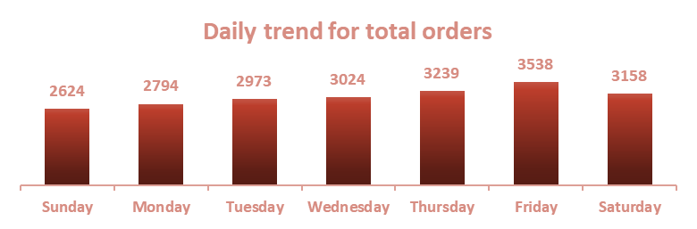

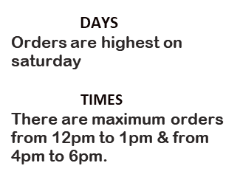
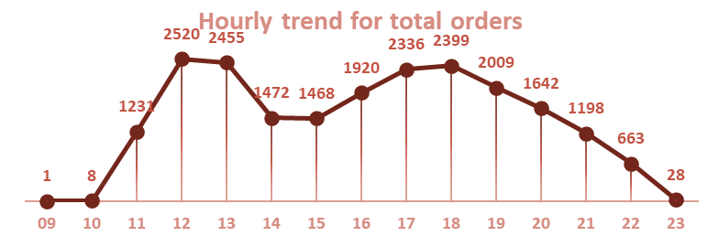
RECOMMENDED ANALYSIS

Slide 7
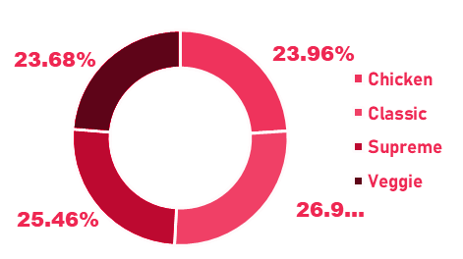
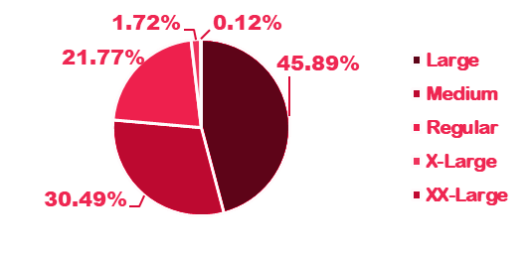
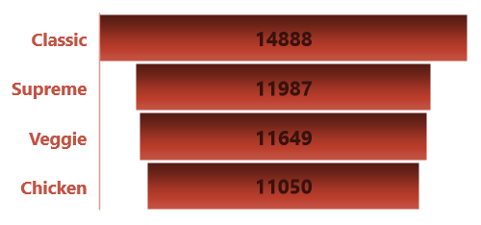

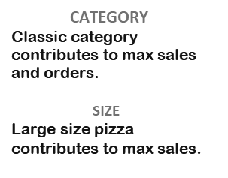

Slide 8
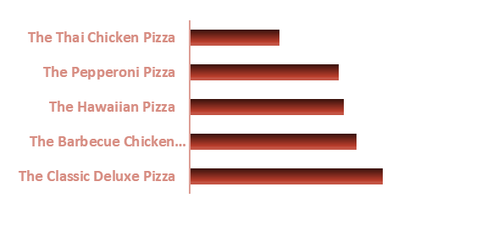
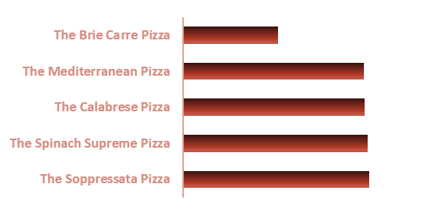

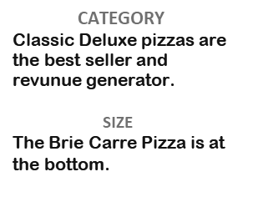

Slide 9
CONCLUSION
In conclusion, this project has provided valuable insights into the sales performance of our pizza restaurant chain. Through meticulous analysis of sales data using SQL and other data analysis techniques such as MS Excel, we have gained a deeper understanding of key aspects such as busiest days and times, sales by category and size, and best and worst sellers.
The findings reveal that Fridays are the busiest days for pizza sales, with peak sales . Additionally, sales are predominantly driven by the classic category, particularly large-sized pizzas, indicating a preference for traditional favourites among our customers. Furthermore, our analysis identifies the Classic Deluxe pizzas as top performers in terms of revenue generation, while The Brie Carre lags behind as a bottom seller.
These insights provide actionable recommendations for optimizing our operations, marketing strategies, and menu offerings. By capitalizing on peak sales times, promoting popular categories and sizes, and potentially reevaluating underperforming menu items, we can enhance overall sales performance and customer satisfaction.

Slide 10
THANK YOU!
PROJECT OWNER: MUSHKAN SAH
Email Id: muskaansah2000@gmail.com
LinkedIn: https://www.linkedin.com/in/mushkan-sah-m200017
Peerlist: https://peerlist.io/mushkan17

